Slide 1
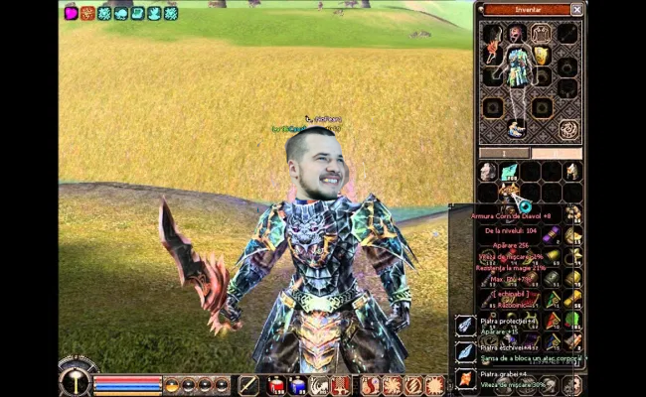

Slide 2
Creating the Conference Management System
Cringe Team

Slide 3
The process of implementing
Understanding the project and think about developing
Creating the diagrams
Redeciding the implementation method
Developing
Analyzing de user roles and hierarchy
Choosing python as developing platform
Further analyzation by creating UML, Use Case and Flow Diagrams
Choosing C# and Qt as frameworks to implement the app
Creating the App, User Guide and Presentation

Slide 4
Our Team
Cringe name and a process worthy of the name
Dragoș Cîrțoroșan
Cărare Claudiu
Sergiu Chiș
Filip Comșa

Slide 5
Understanding the project and think about developing
Steps:
Separating the phases
Deciding on the hierarchy
Discuss with the teachers about misunderstandings
Initially choose Python as implementing language

Slide 6
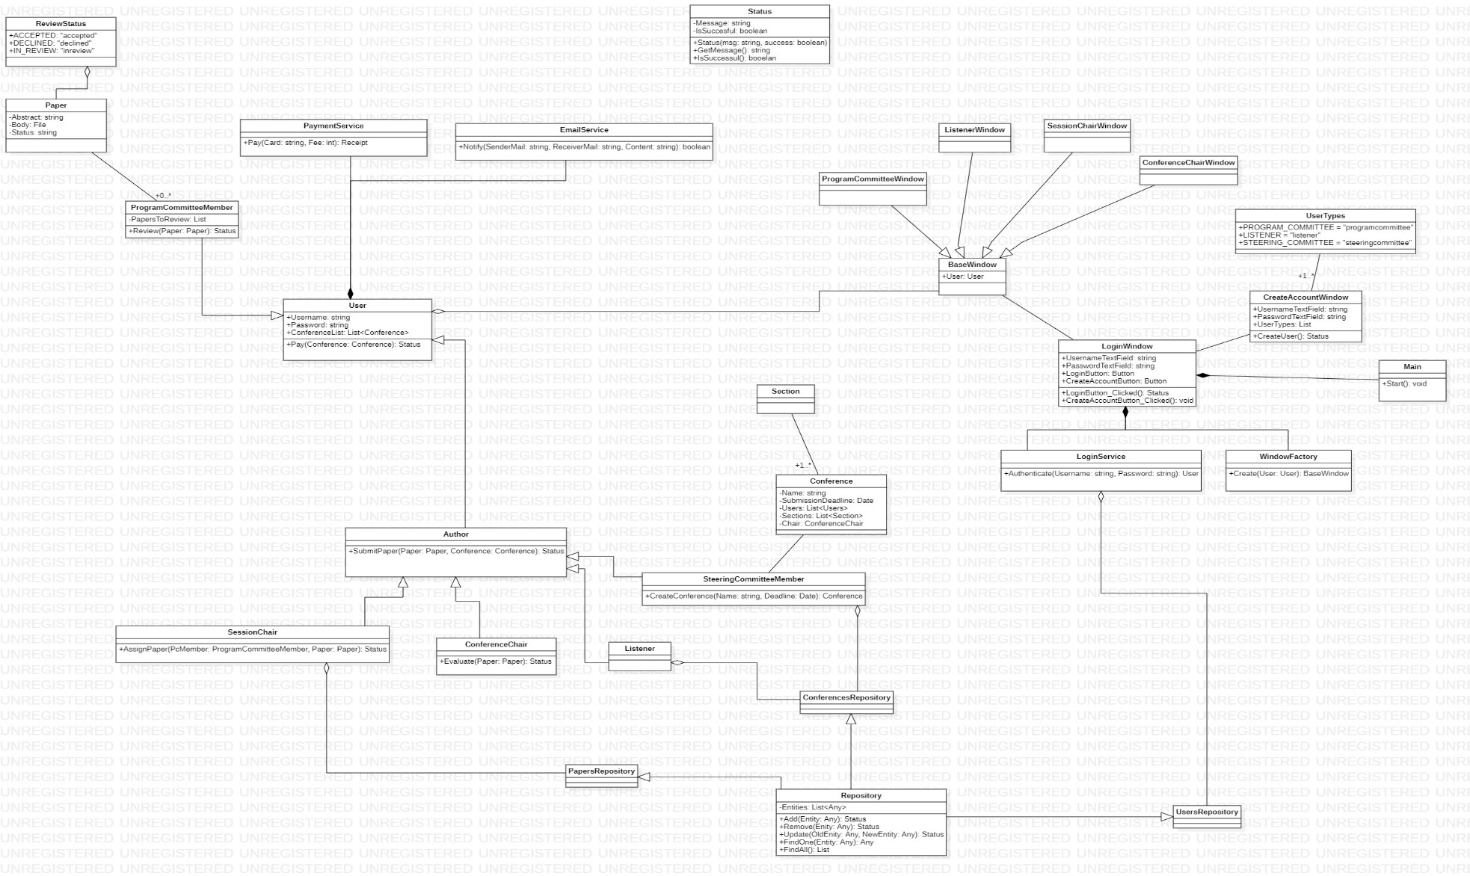
Creating the diagrams
UML Diagram

Slide 7
Use case diagrams

Slide 8
Redeciding the implementation method
We figured out C# might be a better solution for the following reasons:
We had much better understanding of it
Superior code readability and reusability
Actually we started to run out of time and we gave up on learning implementation methods that we weren’t aware of at all

Slide 9
Developing
Was done in gradual quantities, varying from 0 lines of code in the begging of April to most of it being done in the week 13 of the semester, so a quite unproportional work with the time left!
Tools used:
C# + Windows Forms
Visual Studio IDE
Github VCS
Jira Timeplanning (to some extent)
Kudos for Facebook Messenger and @everyone tagging in Discord

